Slide 1

Distributed Systems Week 2 - Sockets
Dr. Thiago Braga Rodrigues
tbrodrigues@ait.ie

Slide 2
Internet Hosts
An internet host is any machine connected to the internet that has an IP address
IP addresses are unique 32 bit numbers, (four bytes), such as 193.1.31.21.
Each part of the number ranges from 0 to 255. This gives 4 billion+ IP addresses.
IPv6 will increase IP addresses to 128 bit numbers.
Distributed Systems - Week 2: Sockets

Slide 3
IPv4
First deployed in 1983 by Advanced Research Projects Agency Networks (ARPANET), IPv4 is still the most used routed protocol, despite its successor IPv6.
IPv4 uses a 32-bit (2³²) address space, meaning that a total of 4,294,967,296 unique IP addresses can be assigned to hosts.
IPv4 is written in a decimal notation where each octet is separated by a dot (i.e, 1.2.3.4)
Distributed Systems - Week 2: Sockets

Slide 4
IPv6
With the rapid growth of internet devices—otherwise known as the Internet of Things (IoT)—around the globe, more IP addresses are required for these devices to exchange data
IPv6 uses 128-bit (2128) addresses, allowing 3.4 x 1038 unique IP addresses. This is equal to 340 trillion trillion trillion IP addresses.
IPv6 is written in hexadecimal notation, separated into 8 groups of 16 bits by the colons, thus (8 x 16 = 128) bits in total.
Distributed Systems - Week 2: Sockets

Slide 5
Hostnames
In addition hosts may have a hostname.
The command hostname will tell you.
Open CMD prompt, type ‘hostname’ and hit enter will display machines’ hostname
If registered with a name server a machine can be located on the Internet using a fully qualified domain name such as "se21.ait.ie"
Distributed Systems - Week 2: Sockets

Slide 6
Hostnames
In the previous example "se21.ait.ie"
se21 is the hostname part, ait the second level domain name and ie the top level domain name.
The Domain Name System (DNS) translates fully qualified domain names into IP addresses (we’ll see how later)
Distributed Systems - Week 2: Sockets

Slide 7
Client/Server Applications
A Client/Server application is a piece of software where the functionality is provided by two processes (programs in execution) a server process and a client process.
Usually these processes are executing on different hosts.
Distributed Systems - Week 2: Sockets

Slide 8
Client/Server Applications (cont)
Normally the client process initiates the contact, specifying the IP address and port number of a service (server process) on the server host.
The port number is a 16 bit integer, (64K possible values).
The server is said to listen on a particular port.
Distributed Systems - Week 2: Sockets

Slide 9
Internet Applications
The port numbers 0-1023 are reserved for well known services such as
Hypertext Transfer Protocol HTTP (80)
File Transfer Protocol ftp (20 and 21)
Remote login - telnet (23)
Simple Mail Transfer Protocol - SMTP (25),
Post Office Protocol - POP2 (109), POP3 (111)
User defined services use other port numbers.
Distributed Systems - Week 2: Sockets

Slide 10
IP Addresses and Java
Java has a class java.net.InetAddress which represents network addresses
Serves three main purposes:
Encapsulates an address
Performs name lookup (converting a host name into an IP address)
Performs reverse lookup (converting the address into a host name)
Distributed Systems - Week 2: Sockets

Slide 11
Structure of Client/Server Applications
It is virtually impossible to ensure that two processes on different hosts start at exactly the same time.
One process (called the server process) starts first and waits for requests on a particular network port
The server process is said to provide a service.
Distributed Systems - Week 2: Sockets

Slide 12
Structure of Client/Server Applications
Typically a request arrives, it is processed, and the process continues waiting for more requests.
Often server processes are multi-threaded in order to improve performance. When one thread is blocked, other threads can service other incoming requests.
Distributed Systems - Week 2: Sockets

Slide 13
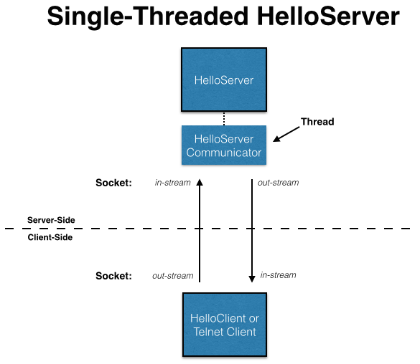
The Server (Single Threaded)
The server blocks on the accept() until a request arrives from a client
Distributed Systems - Week 2: Sockets

Slide 14
TCP/IP Sockets Interface
Distributed Systems - Week 2: Sockets

Slide 15
The TCP/IP Sockets Interface
The Application Program Interface (API) to TCP/IP is known as the Sockets interface.
Socket interfaces exist for C, Java, Perl and other languages.
The Java API is defined in the java.net package.
Distributed Systems - Week 2: Sockets

Slide 16
A Java Example
Server
Accepts a connection from the client.
Reads a name and sends back the message ″Hello <name> from Hello Server″
Closes the connection.
Client
Opens a connection to the server.
Sends a String (name)
Distributed Systems - Week 2: Sockets

Slide 17
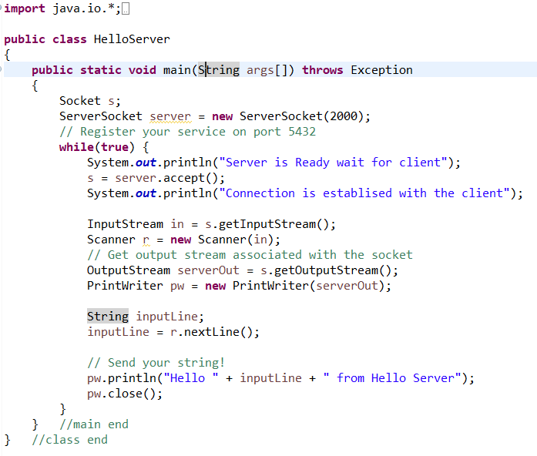
HelloServer.java
Creates a connection to port 2000
Listens for a connection to be made to this socket and accepts it.
Gets the incoming stream of bytes
Converts the stream of bytes into text
Sends byte stream to the socket
Outputs text as a byte stream
Gets the next line of text from the input
Prints to the output
Distributed Systems - Week 2: Sockets

Slide 18
HelloServer - Comments
The server listens on port 2000
The server loops for ever [while(true)].
The server associates a Scanner with an InputStream (object) with the socket.
Reads from this Scanner to accept data from the client.
Gets a PrintWriter linked up to the Socket OutputStream.
Writes to this.
Distributed Systems - Week 2: Sockets

Slide 19
HelloServer - Comments
The server closes the connection with the client when finished.
Then is ready to accept() another connection.
Distributed Systems - Week 2: Sockets

Slide 20
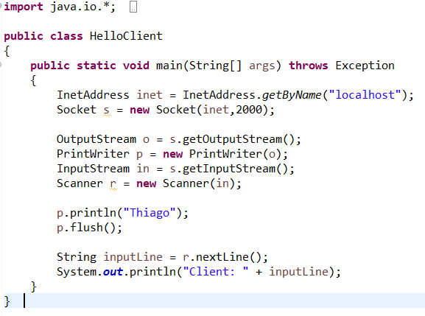
HelloClient.java
Gets the IP address for localhost
Buffer not full so must be flushed
Distributed Systems - Week 2: Sockets

Slide 21
HelloClient - Comments
The client connects to the server by creating a Socket object, specifying the IP address and port number (2000).
The client associates an OutputStream and then a PrintWriter with the socket and sends data by writing to that PrintWriter.
Note that when the client writes data (p.println()), the data is not actually sent.
Distributed Systems - Week 2: Sockets

Slide 22
HelloClient - Comments
The data is buffered (stored in memory) and is only sent when the buffer is full.
This makes TCP/IP more efficient.
Hence the need to invoke flush() on the PrintWriter.
This forces the data to be sent even if the buffer is not full (which it is not in this case.)
Distributed Systems - Week 2: Sockets

Slide 23
HelloClient - Comments
Having sent the data (request), the client reads the response back from the server.
Prints it out, and finishes.
Distributed Systems - Week 2: Sockets

Slide 24
TCP/IP – Two Issues

Slide 25
TCP/IP byte stream
TCP/IP supports a byte stream.
The InputStream and OutputStream (abstract) classes provide methods to read() and write() bytes.
We want to use Strings (or Integers or Doubles etc. etc.)
Two things need to happen
Buffering
Data Conversion
Distributed Systems - Week 2: Sockets

Slide 26
TCP/IP byte stream
Buffering
The bytes need to be buffered (stored in memory) until we can read a number of them and get a String.
Conversion
The bytes need to be converted into Unicode characters and then Strings.
This is provided by the Scanner and PrintWriter classes.
Distributed Systems - Week 2: Sockets

Slide 27
Data Conversion
The Scanner converts a byte stream into a String.
The same happens with output.
A String is converted to a byte stream by the PrintWriter.
Distributed Systems - Week 2: Sockets

Slide 28
Synchronization
Notice that the Server and Client are tightly coupled.
Each write has a corresponding read on the other side.
Suppose the Server had two nextLine() calls instead of one.
The system would deadlock.
Distributed Systems - Week 2: Sockets

Slide 29
Synchronization
Reads and writes need to be synchronized.
This is not really a problem in this simple example.
For more complicated examples it can be.
Distributed Systems - Week 2: Sockets

Slide 30
TCP/IP Sockets API
The java/net API
Distributed Systems - Week 2: Sockets

Slide 31
The java.net package
The main classes are:
ServerSocket
Socket
InetAddress
Distributed Systems - Week 2: Sockets

Slide 32
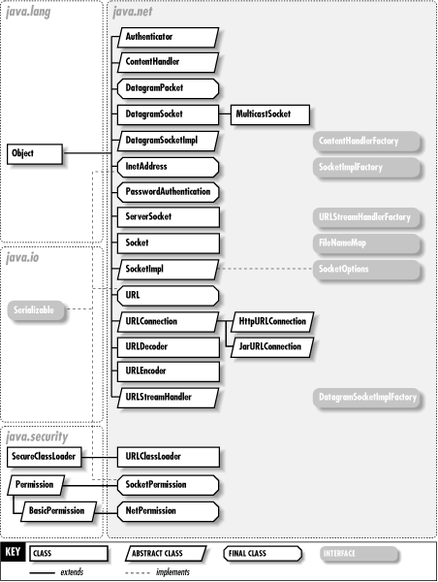
The java.net package
Distributed Systems - Week 2: Sockets

Slide 33

Class ServerSocket
Encapsulates the mechanism for a server to accept connections from a client.
The server creates a ServerSocket specifying a particular port number and waits for connections from clients.
The method accept() blocks until a connection arrives from a client.
The server gets a Socket (connection) from an accept().
Distributed Systems - Week 2: Sockets

Slide 34
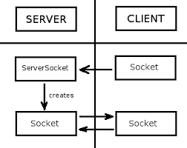
Class ServerSocket
Distributed Systems - Week 2: Sockets

Slide 35
Class Socket
A socket is an endpoint for communication between client and server.
The client creates a Socket object to initiate the connection.
The server is returned a Socket by the accept() method invoked on the ServerSocket object.
Distributed Systems - Week 2: Sockets

Slide 36
Class Socket
Both client and server associate InputStreams and OutputStreams with the Socket.
The OutputStream of one is associated with the InputStream of the other and vice-versa.
A single Socket supports communication both ways.
Distributed Systems - Week 2: Sockets

Slide 37
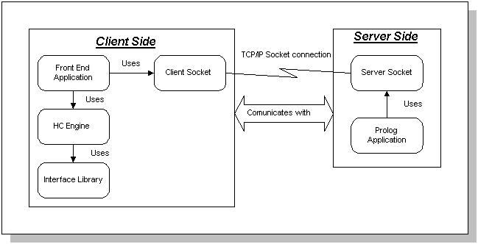
ServerSocket / Socket 2 Way communication
Distributed Systems - Week 2: Sockets

Slide 38
Class InetAddress
Client gets an InetAddress object for the server it wants to connect to.
By invoking the static function getByName().
Can pass a fully qualified hostname or IP address.
The InetAddress object is passed as a parameter to Socket constructor.
Distributed Systems - Week 2: Sockets

Slide 39
Reading a Text File

Slide 40
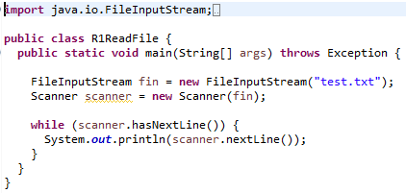
R1ReadFile
Distributed Systems - Week 2: Sockets

Slide 41
R1ReadFile
Reads from the file ″test.txt″ in the project folder. (Not the src folder)
scanner.hasNextLine() returns false if there is no more input.
Distributed Systems - Week 2: Sockets

Slide 42
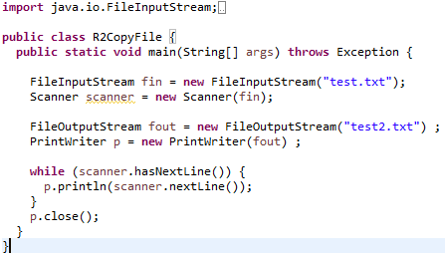
R2CopyFile.java - Buffering
Distributed Systems - Week 2: Sockets

Slide 43
R2CopyFile.java - Buffering
Notice that the copy won′t work if the p.close() is not called.
The println() method buffers output in memory.
This means that when println() is called with a String argument, the String is not actually written to file, but is stored in a buffer.
p.close() flushes the buffer.
Distributed Systems - Week 2: Sockets

Slide 44
File Server

Slide 45
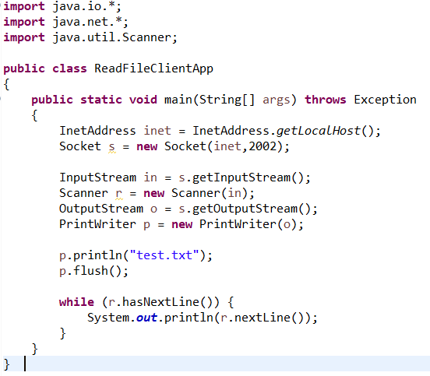
Client
Distributed Systems - Week 2: Sockets

Slide 46
Client
Open connection to Server
Send name of file (and flush())
Read back from the Scanner until no more lines. (See R1ReadFile.java).
Distributed Systems - Week 2: Sockets

Slide 47
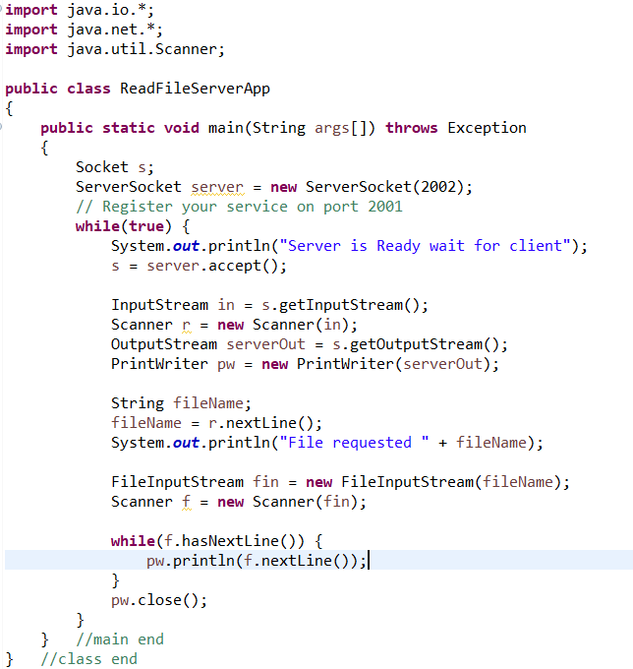
Server
Distributed Systems - Week 2: Sockets

Slide 48
Server
Accept connection from the Client.
Set up Scanner and PrintWriter.
Read the name of a file.
Get a FileInputStream for a file of this name (see R1ReadFile.java).
Get a second Scanner for the file (say f).
Copy from f to pw (see R2CopyFile.java).
Distributed Systems - Week 2: Sockets

